Slide 1
RNN Project
Erik Lidbeck

Slide 2
Introduction
A bit late…
Why the RNN project?
Relevant to me
Useful knowledge
ConvLSTM Spatiotemporal learning
How did I approach the project?
Sequence-to-Sequence
ConvLSTM[1]
The Pytorch ConvLSTM problem
What model am I presenting….
Encoder-Decoder architecture
[1] Shi et al. “Convolutional LSTM Network: A Machine Learning Approach for Precipitation Nowcasting”, 2015

Slide 3
The Model
Encoding
Decoding
Conv3D
3
30
30
30
30
30
30
Input Sequence (3x5)
ConvLSTM x1
ConvLSTM x5
Predicted Sequence
3x5

Slide 4
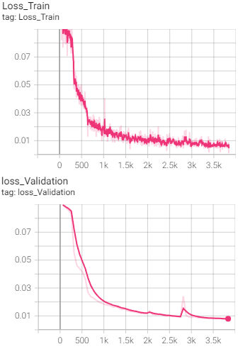
32x32
# Kernels: 30 / Layer
Size: 3
Padding: 1
Stride: 1
Batch size: 15
Epochs: 60
Augment: RandomHorizontalFlip(0.3)
LR: 2e-4
L2: 2e-8
Test: 7.5e-3 MSE

Slide 5
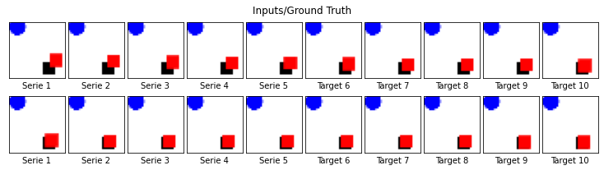
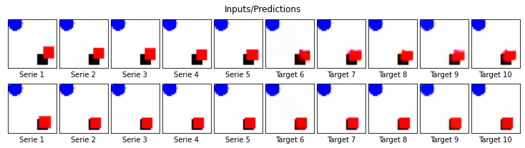
Visual results

Slide 6
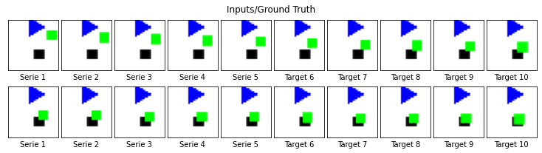
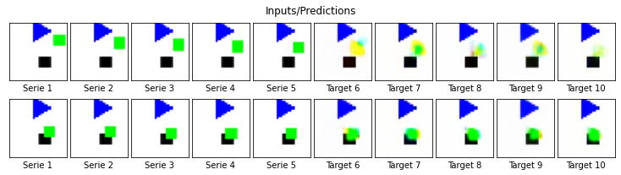
Worst results

Slide 7
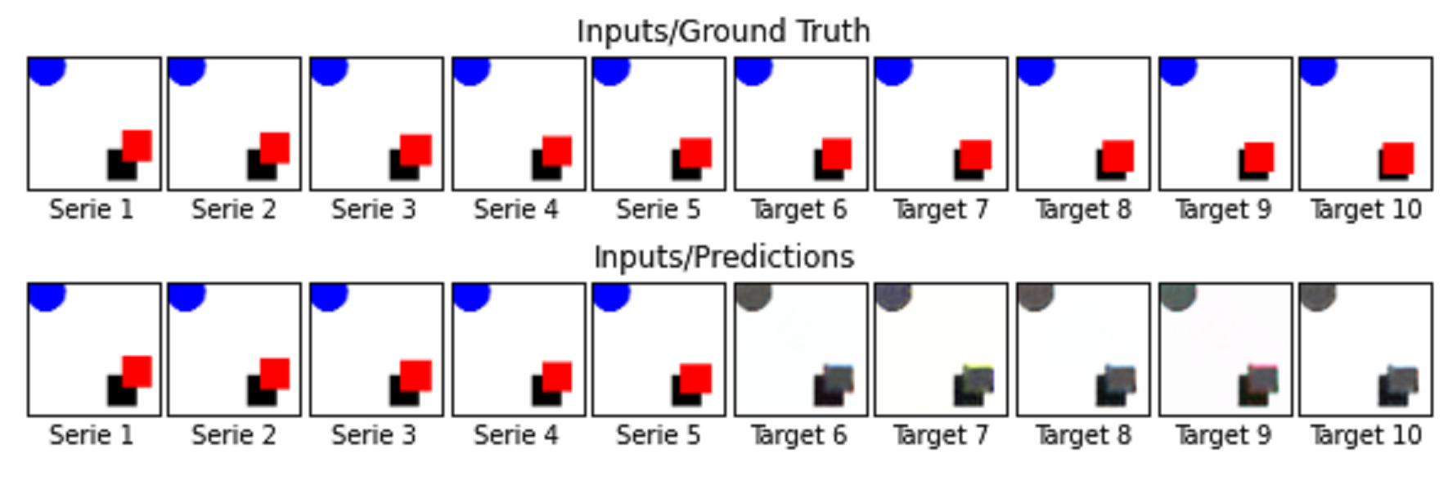
Some funny results
…few kernels

Slide 8
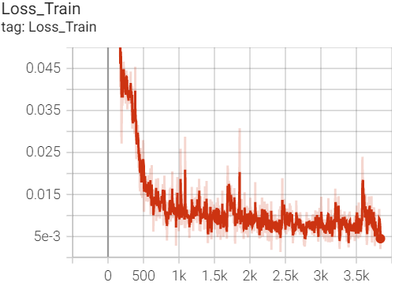
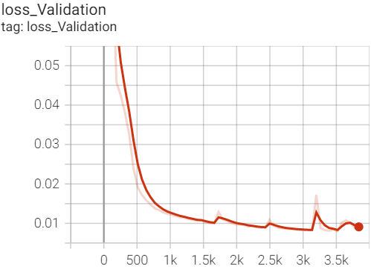
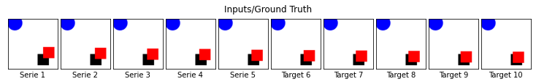
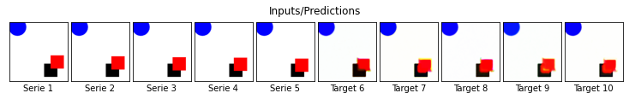
128x128
# Kernels: 30 / Layer
Size: 3
Padding: 1
Stride: 1
Batch size: 15
Epochs: 60
Augment: Same as before
LR: 2e-4
L2: 2e-8
Test: 8.5e-3 MSE

Slide 9
The end
Questions?

